Slide 1

DATABASE
TECHNOLOGIES
Query Processing and Optimization
Suresh Jamadagni
Department of Computer Science
and Engineering

Slide 2

DATABASE TECHNOLOGIES
Query processing and optimization
Suresh Jamadagni
Department of Computer Science and Engineering

Slide 3
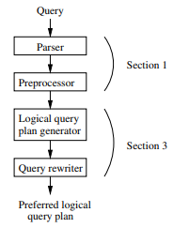
DATABASE TECHNOLOGIES
Query Execution – Query Compiler
Query Parsing and Preprocessing
Parser - Parser takes text written in a language such as SQL and converts it to a parse tree
Preprocessor - Responsible for semantic checking. The preprocessor replaces views in a parse tree by the objects which represent how the view is constructed from the base tables.
Logical query plan generator – Converts parse trees into logical query plans
Query rewriter – Rewrites logical query plans and selects the preferred logical query plan.

Slide 4
DATABASE TECHNOLOGIES
Query Execution – Query Compiler – Parser
Syntax Analysis and Parse Trees
Parser - Parser takes text written in a language such as SQL and converts it to a Parse Tree
The nodes of a parse tree corresponds to
Atoms - lexical elements such as keywords (e.g., SELECT), names of attributes or relations, constants, parentheses, operators and other schema elements
Syntactic categories - which are names for families of query subparts that all play a similar role in a query such as group by, order by, having
If a node is an atom, then it has no children
If a node represents a syntactic category, then its children are described by one of the rules of the grammar for the language

Slide 5
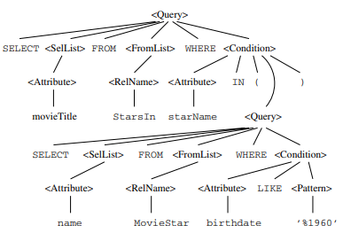
DATABASE TECHNOLOGIES
Query Execution – Query Compiler – Parser
Syntax Analysis and Parse Trees
SELECT movieTitle
FROM StarsIn
WHERE starName IN
( SELECT name FROM MovieStar
WHERE birthdate LIKE ’%1960’ );
Syntactic Category
(Intermediate Nodes)
Atoms
(Leaf Nodes)

Slide 6



DATABASE TECHNOLOGIES
Query Execution – Query Compiler – Parser
Grammar for a Simple Subset of SQL
The syntactic category is intended to represent (some of the) queries of SQL
<Query> ::= SELECT <SelList> FROM <FromList> WHERE <Condition>
The syntactic categories <SelList> and <FromList> represent lists that can follow SELECT and FROM respectively
The syntactic category <Condition> represents SQL conditions

Slide 7
DATABASE TECHNOLOGIES
Query Execution – Query Compiler – Parser
Example:
Consider the following relations
StarsIn (movieTitle, movieYear, starName)
MovieStar (name, address, gender, birthdate)
Find the movies with stars born in 1960
SELECT movieTitle
FROM StarsIn
WHERE starName IN
( SELECT name
FROM MovieStar
WHERE birthdate LIKE ’%1960’ );

Slide 8
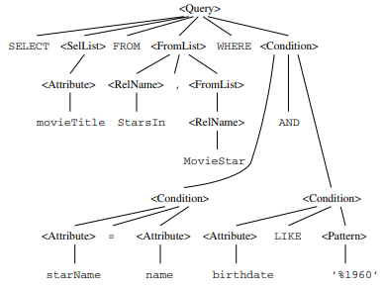
DATABASE TECHNOLOGIES
Query Execution – Query Compiler – Parser
Example:
Consider the following relations
StarsIn (movieTitle, movieYear, starName)
MovieStar (name, address, gender, birthdate)
Find the movies with stars born in 1960
SELECT movieTitle
FROM StarsIn, MovieStar
WHERE starName = name AND
birthdate LIKE ’%1960’;

Slide 9
DATABASE TECHNOLOGIES
Query Execution – Query Compiler – Preprocessor
Preprocessor
The preprocessor is also responsible for semantic checking
Semantic rules
Check relation uses - Every relation mentioned in a FROM-clause must be a relation or view in the current schema
Check and resolve attribute uses - Every attribute that is mentioned in the SELECT or WHERE clause must be an attribute of some relation in the current scope.
Check types - All attributes must be of a type appropriate to their use. Operators are checked to see that they apply to values of appropriate and compatible types

Slide 10
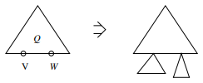
DATABASE TECHNOLOGIES
Query Execution – Query Compiler – Preprocessor
Preprocessing Queries Involving Views
When an operand in a query is a view, the preprocessor needs to replace the operand by a piece of parse tree that represents how the view is constructed from the base tables
A query Q is represented by its expression tree in relational algebra by views V and W
To form the query over base tables, substitute for each leaf in the tree for Q that is a view, the root of a copy of the tree that defines that view
The resulting tree is a query over base tables that is equivalent to the original query using views

Slide 11
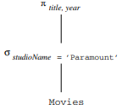
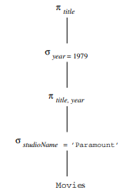
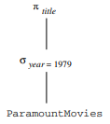
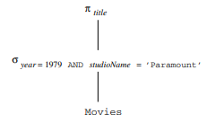
DATABASE TECHNOLOGIES
Query Execution – Query Compiler – Preprocessor
Preprocessing Queries Involving Views Example
CREATE VIEW ParamountMovies AS
SELECT title, year
FROM Movies
WHERE studioName = ’Paramount’;
Query:
SELECT title
FROM ParamountMovies
WHERE year = 1979;

Slide 12
THANK YOU
Suresh Jamadagni
Department of Computer Science and Engineering
sureshjamadagni@pes.edu

